Slide 1
Google Merchandise Store
Group 2
Tianyi Fan, Zheng Huang, Ziyan Wang, Jun Yin, Jiawei Zhu

Slide 2

Goals and Objectives
Get deeper understanding of Google Merchandise Store’s customers.
Focus on U.S. customers.
The first quarter of 2019.
Enhance the website performance.
Seek opportunities to improve the overall performance and profit.

Slide 3
Business Problem Statement
What is the current profit structure? / What brings the most revenue?
How customers act on the website?
Traffic Sources
Profit Structure
Customer Behavior
Behavior Flow
Goal Completion
Where the customer comes from? / Who brings more traffic?
How GMS performs during 1st Quarter 2019?
Which step does customers quit the most？
3

Slide 4
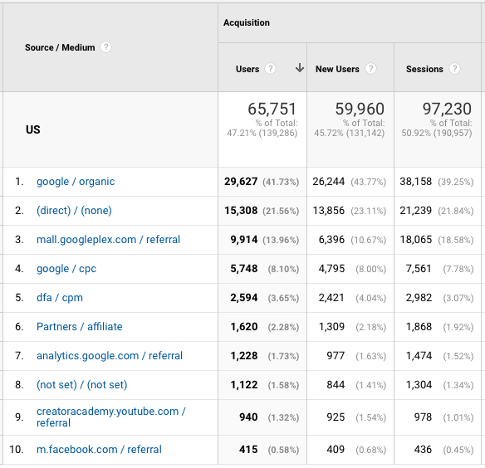
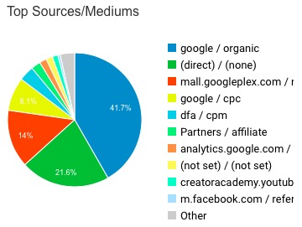
Traffic Sources Analysis Where the customer comes from?
4

Slide 5
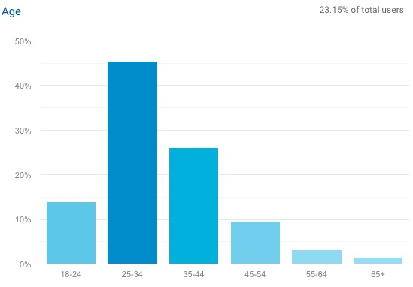
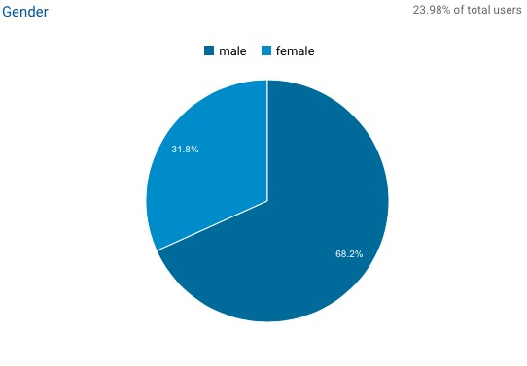
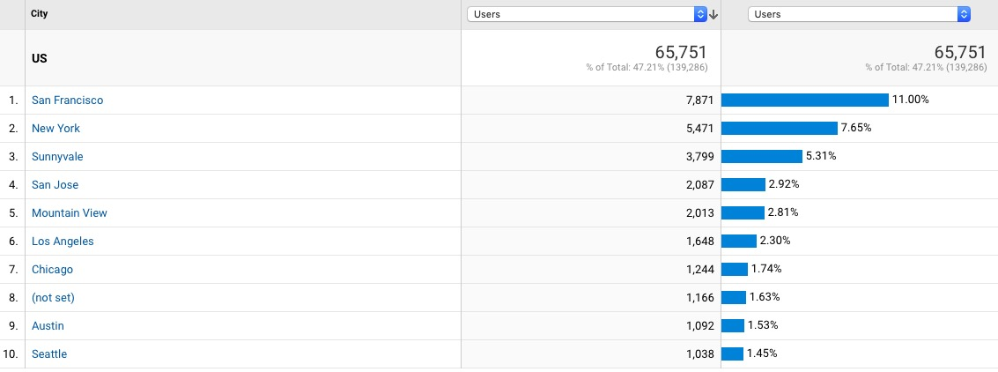
Customer Segments Analysis Who brings more traffic?

Slide 6
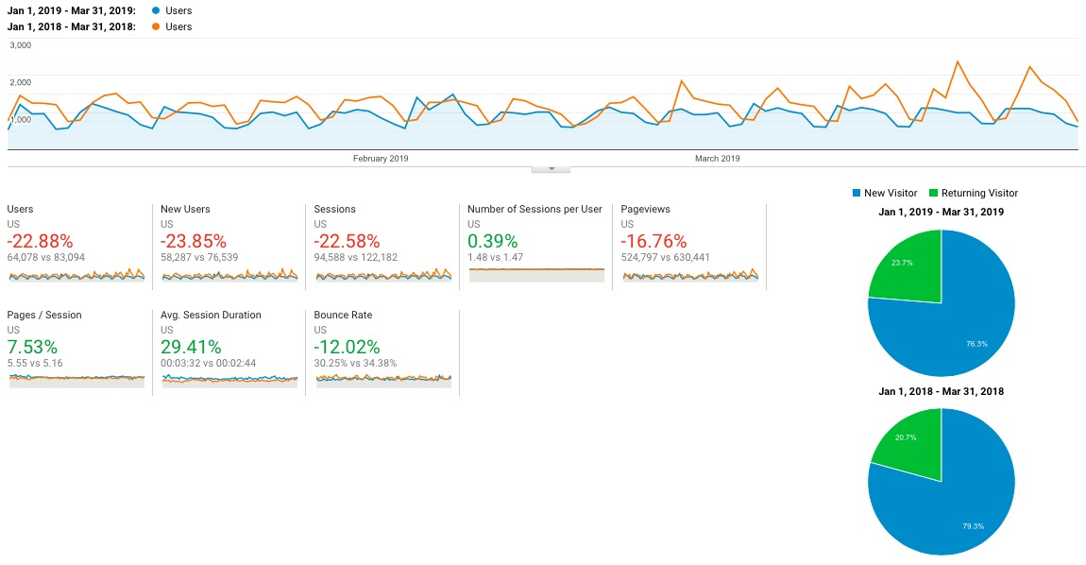
Customer Behavior Analysis How customers act on the website?

Slide 7
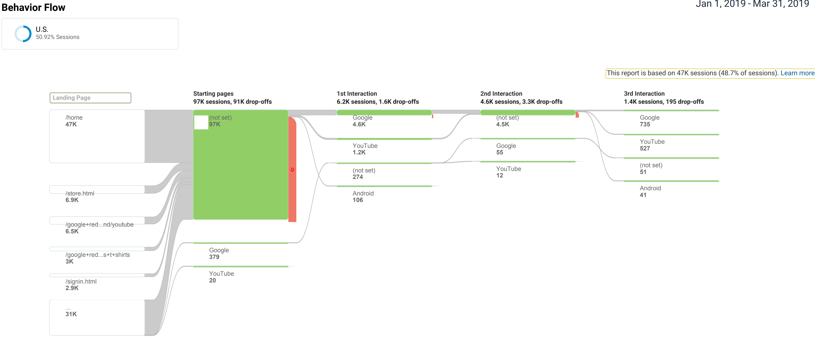
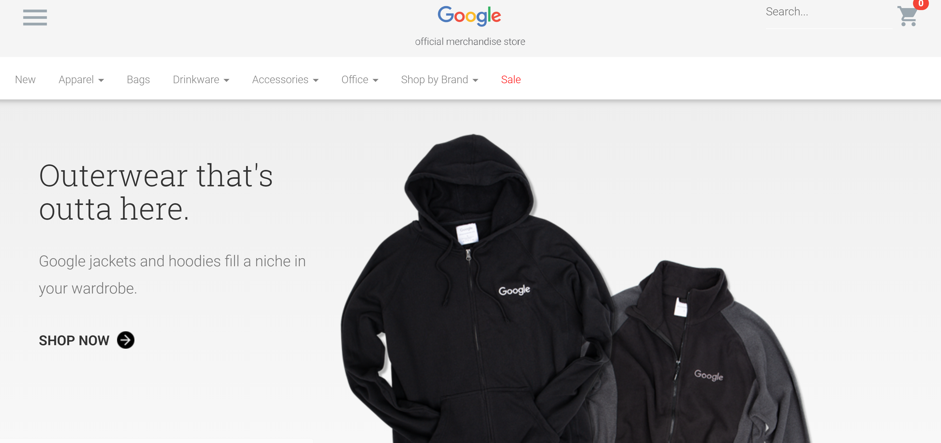
Behavior Flow Analysis Which step does customers quit the most？
7

Slide 8
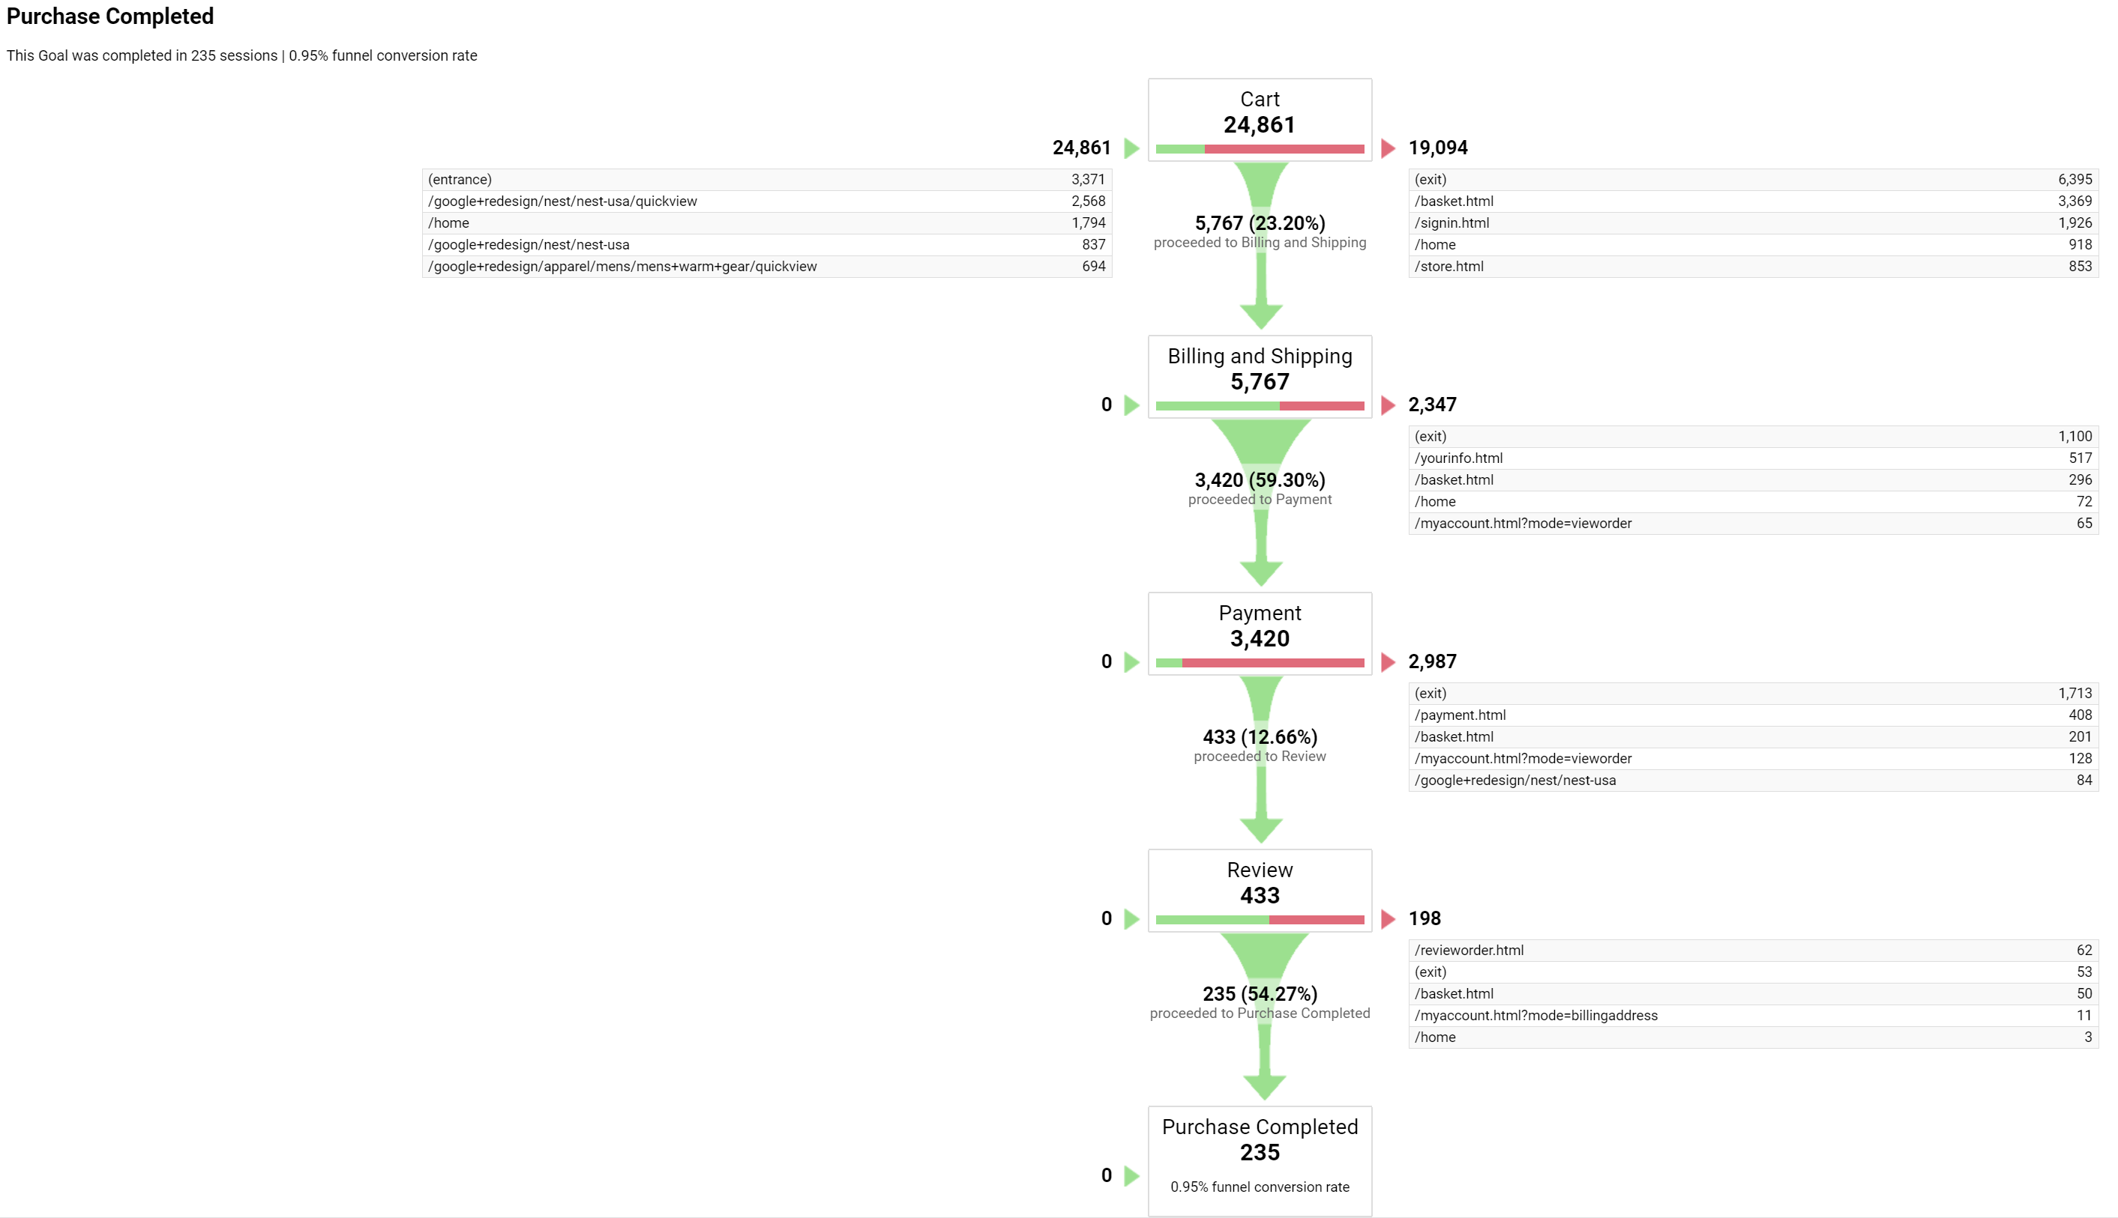
Profit Structure Analysis What is the current profit structure?

Slide 9
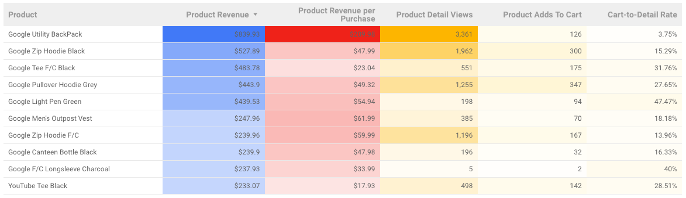
Product Analysis What brings the most revenue?

Slide 10
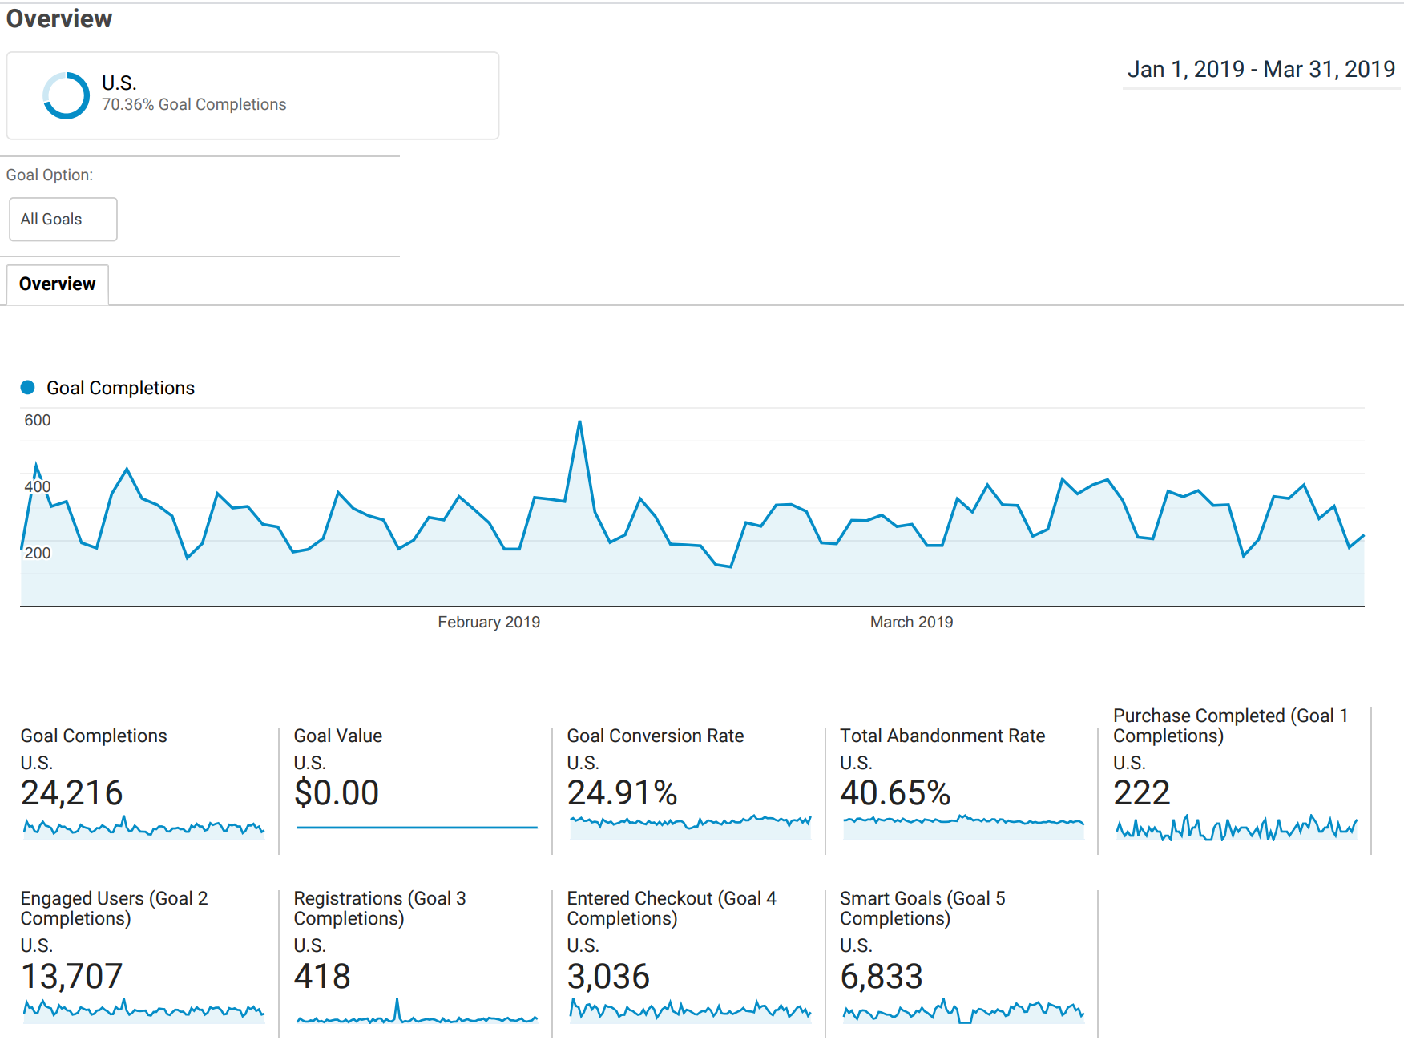
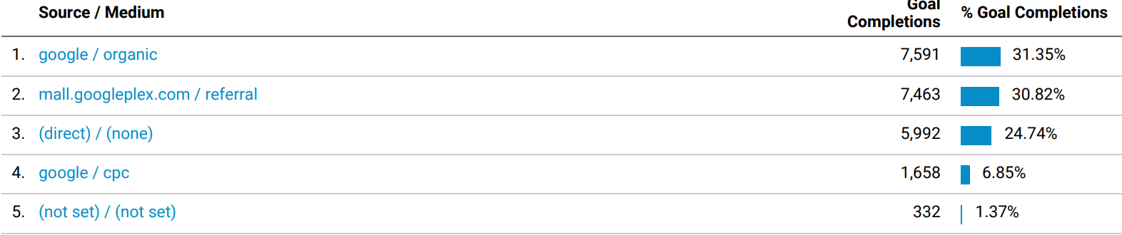
Goal Completion Analysis How GMS performs during 1st Quarter 2019?
10

Slide 11
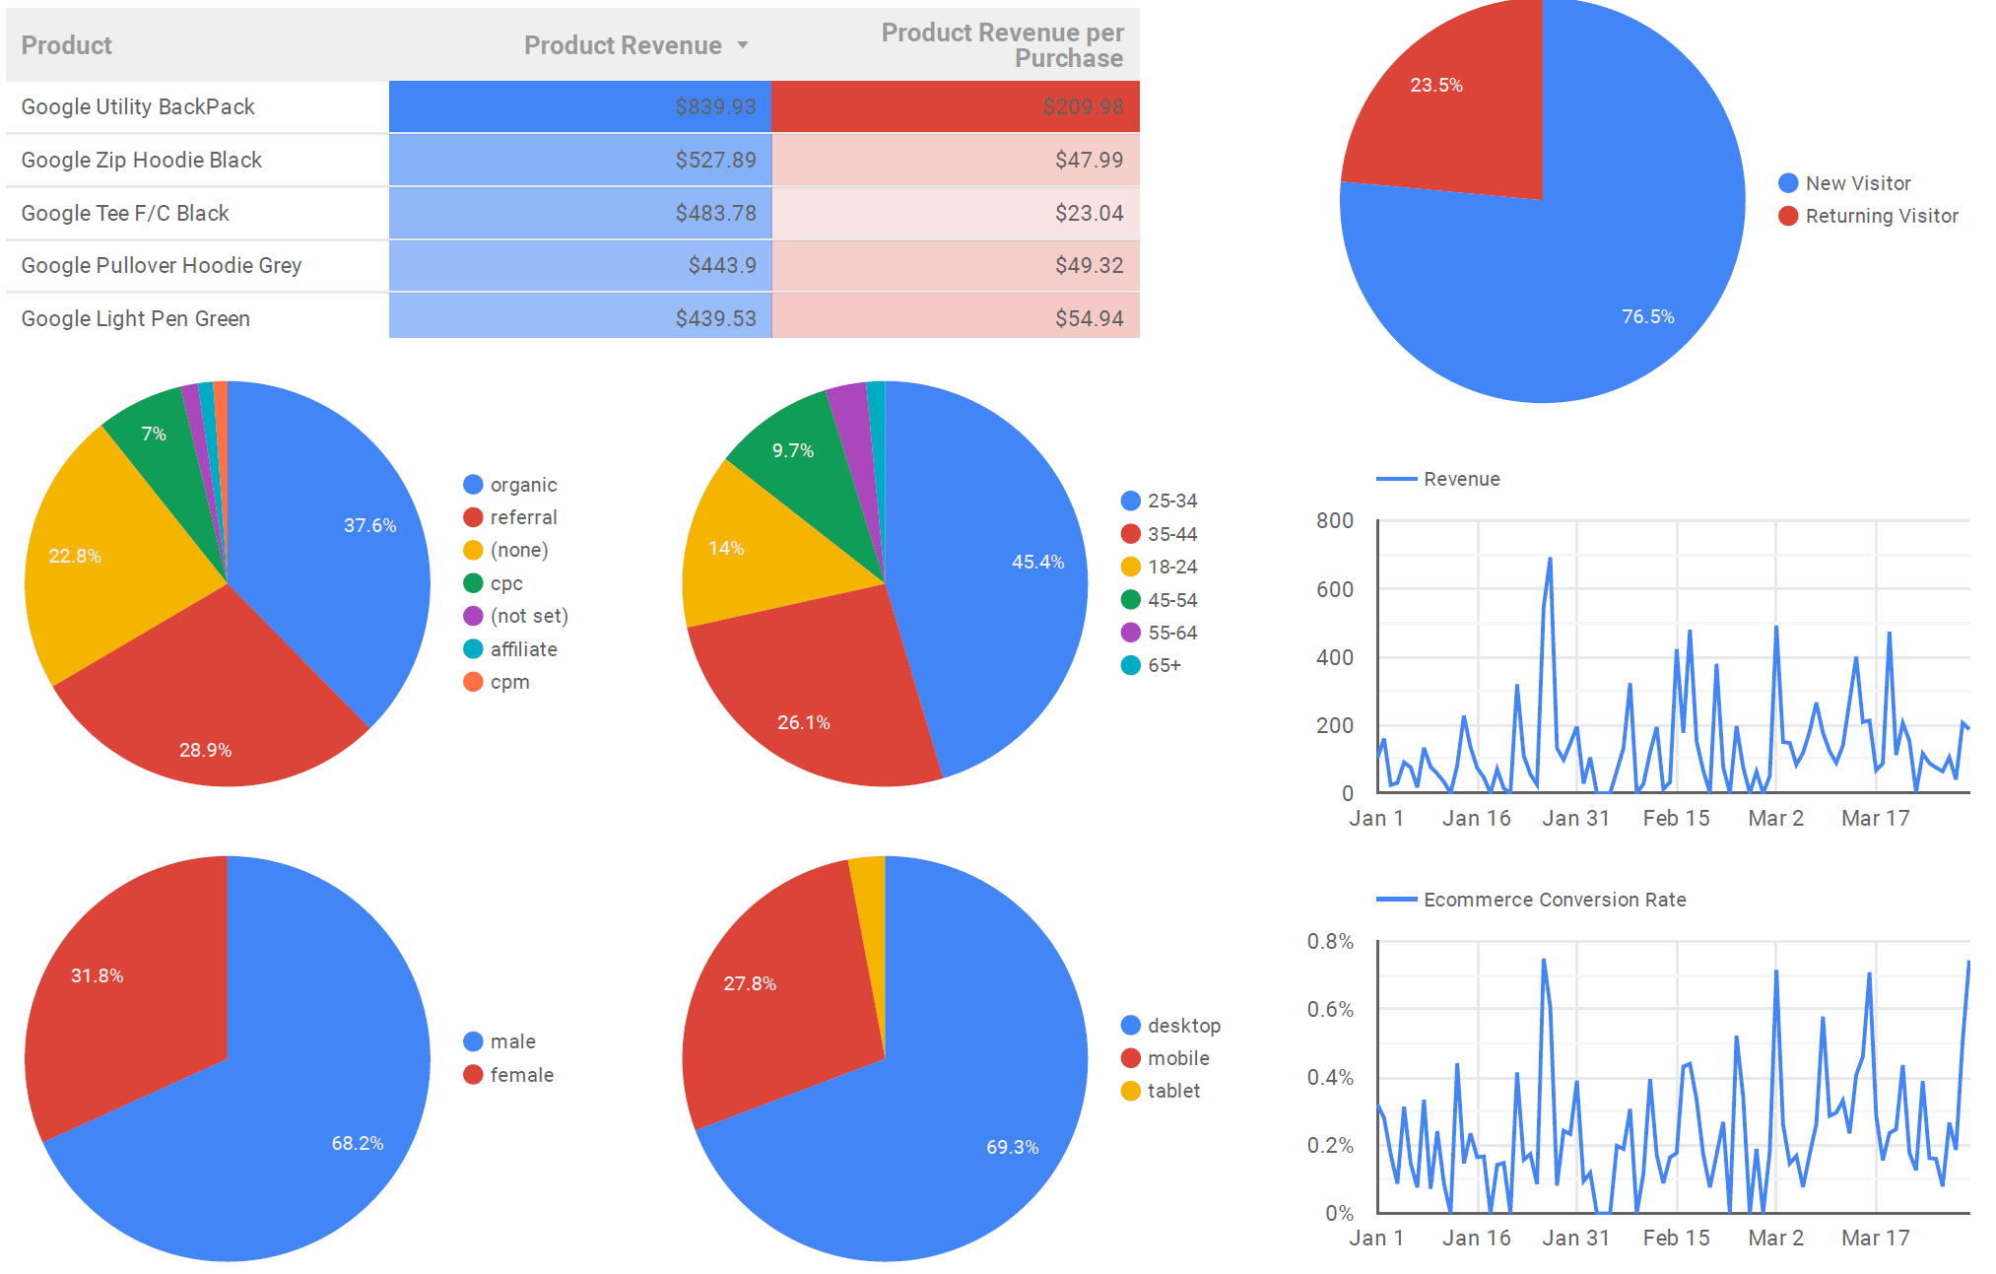
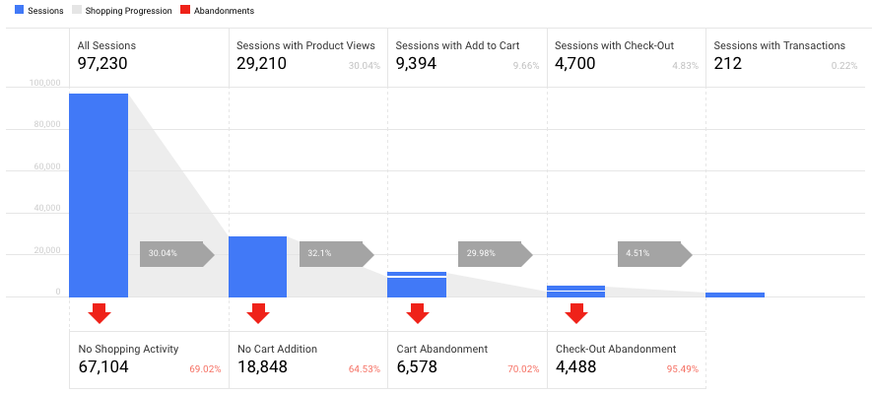
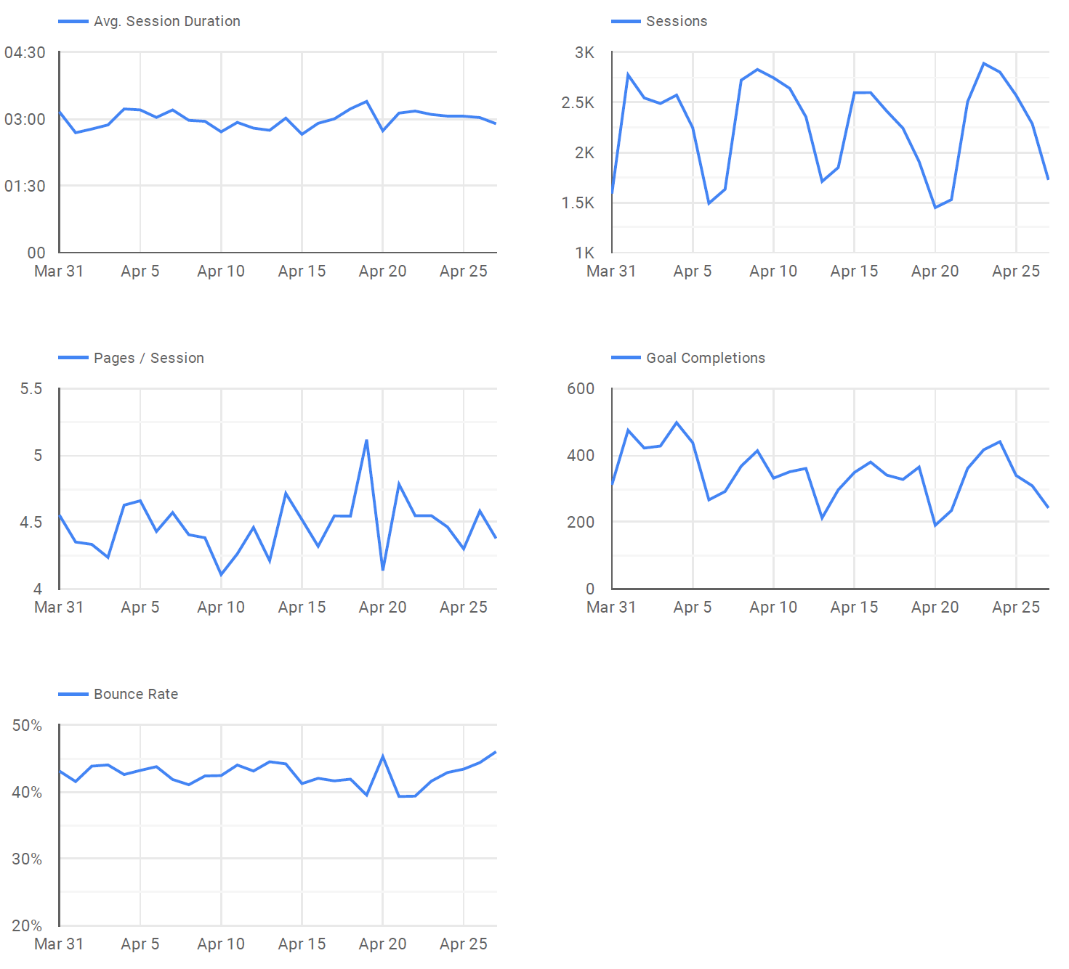
KPI Dashboard
11

Slide 12
Refined Business Problems and Recommendations
How to improve traffic?
Promote the website through various sources (ads, social media) to attract new users.
Provide better online services (responsive site, fast site).
How to prevent the quit from the website?
Affinity targeting: analyze customer’s interests and target to different segments.
Collect customers data and provide appropriate promotions and product recommendations.
Improve the website designation.
How to improve profit?
Provide more attractive products.
Build relationships with suppliers to provide more selections for products.
Provide more sufficient check out procedures.
12

Slide 13

Conclusions and Future Scenarios
Google/Organic source generated the most traffic.
Most visitors quit from the starting pages
Traffic and revenues are generated more during weekday then weekend
Only small amount of users comment on the products they purchased
Keep track with the changes in traffic source and users behavior would help the website to understand the users and further to enhance the overall performance.
The sparsity would be a problem if the website wants to make targeting recommendations and promotions in the future.

Slide 14
Reference
Campaigns and traffic sources - Analytics Help. (n.d.). Retrieved from https://support.google.com/analytics/answer/6205762?hl=en
Shewan, D. (2018, October 31). 25 Ways to Increase Traffic to Your Website. Retrieved April 28, 2019, from https://www.wordstream.com/blog/ws/2014/08/14/increase-traffic-to-my-website
Secrist, M. (2019, March 20). Which Type of Content Brings In the Most Traffic? Retrieved from https://www.bkacontent.com/which-type-of-content-brings-in-the-most-traffic/
Understanding User Behavior with Google Analytics - Analytics Help. (n.d.). Retrieved from https://support.google.com/analytics/answer/7126596?hl=en
14

Slide 15
Thank you

